Slide 1
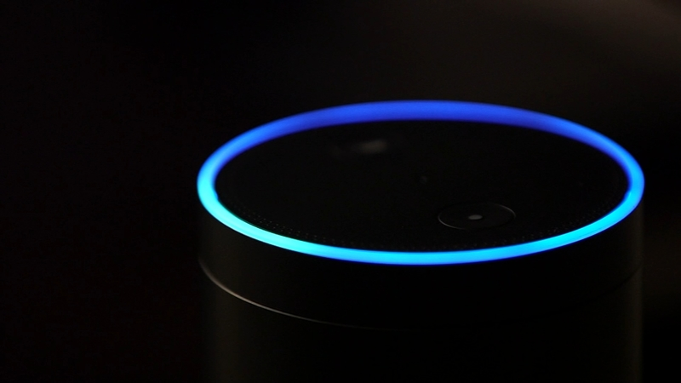
ARTIFICIAL INTELLIGENCE IN
ALEXA BY AMAZON
-ESHA CHAUGULE
GAYATRI DESHMANE

Slide 2

What is Alexa?
SMART SPEAKER
Controlled by our voice
Music, News, Weather, Sports
Invading homes

Slide 3
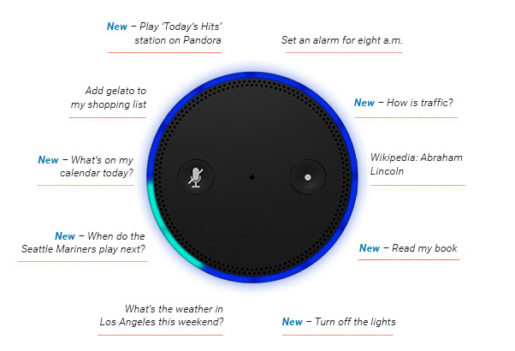

Slide 4
What is Alexa?
‘Alexa’ is the wake word
Continually learns and adapts to our speech patterns
8 languages
Business aspects
SMART SPEAKER
Controlled by our voice
Music, News, Weather, Sports
Invading homes

Slide 5
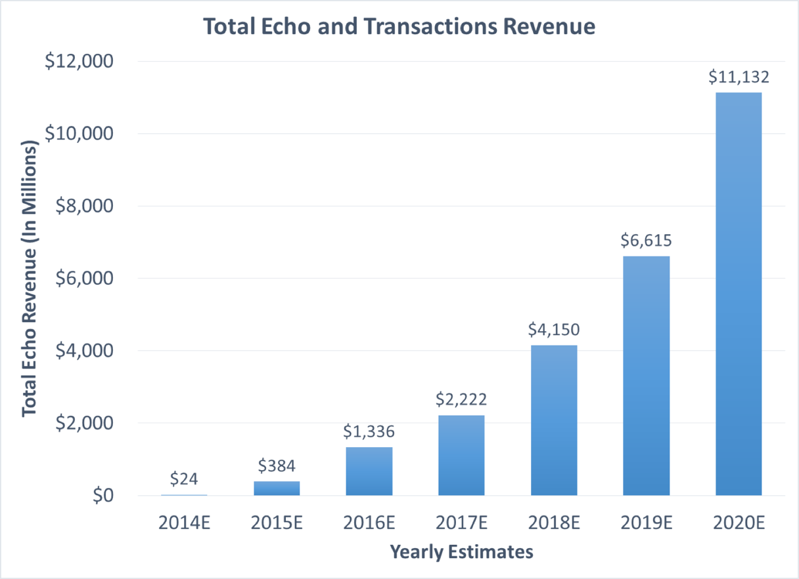



Slide 6
What is Alexa?
ALEXA is the wake word
Continually learns and adapts to our speech patterns
8 languages
Business aspects
SMART SPEAKER
Controlled by our voice
Music, News, Weather, Sports
Invading homes
How does it actually work

Slide 7







WHAT HAPPENS AFTER THE REQUEST(NLG)?

Slide 8
What is Alexa?
ALEXA is the wake word
Continually learns and adapts to our speech patterns
8 languages
Business aspects
SMART SPEAKER
Controlled by our voice
Music, News, Weather, Sports
Invading homes
How does it actually work
Signal Processing

Slide 9
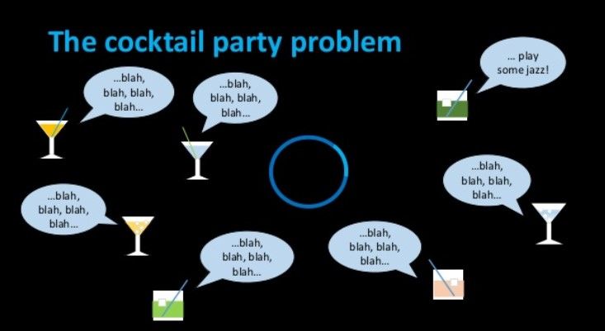
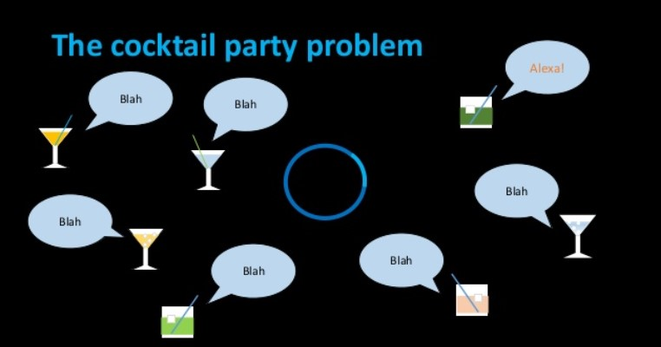

Slide 10
Signal Processing(AEC)
WAKE WORD DETECTION
CANCELLATION
SIGNAL SENT TO AVS
To minimise false positives and false negatives
Make sense of the audio by cleaning the signal
Convert signal into text, with user’s frequency and pitch

Slide 11
What is Alexa?
ALEXA is the wake word
Continually learns and adapts to our speech patterns
8 languages
Business aspects
SMART SPEAKER
Controlled by our voice
Music, News, Weather, Sports
Invading homes
How does it actually work
Signal Processing
Alexa Skills

Slide 12

ANALYSIS OF AN “ORDER” (NLU)
04
UTTERANCE
WAKE WORD
Alexa identifies the user’s intent from given Utterance and responds accordingly. Utterance decides what user wants Alexa to perform.
Saying ‘Alexa’ wakes up the device. The wake word puts Alexa into the listening mode and ready to take instructions from users.
01
03
INVOCATION NAME
LAUNCH
Action, command or question. Eg, ask, add, play
Keyword used to trigger a specific ‘skill’. Eg, FitBit, Spotify, Domino’s
02

Slide 13
What is Alexa?
ALEXA is the wake word
Continually learns and adapts to our speech patterns
8 languages
Business aspects
SMART SPEAKER
Controlled by our voice
Music, News, Weather, Sports
Invading homes
How does it actually work
Signal Processing
Alexa Skills
Inside Alexa Voice Service?

Slide 14
WHAT HAPPENS INSIDE ‘ALEXA VOICE SERVICE’(TTS)?

Slide 15

How AI is used in Alexa

Slide 16
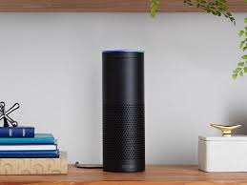
Technologies used by alexa:
ASR(automatic speech recognition)
TTs(text to speech)
NLU(Natural Language Understanding)

Slide 17
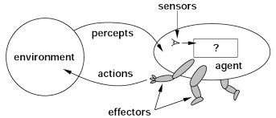
Agent
Agent can sense or percept from environment.
Agent is work upon PEAS model.
P-Performance
E-Environment
A-Actions
S-Sensors
Alexa is intelligent agent.

Slide 18
PEAS
Performance Measure: Performance measure is the unit to define the success of an agent.Performance varies with agents based on their different percepts.
Environment: Environment is the surrounding of an agent at every instance.It keeps changing with time .
Actuators: These are the tools, equipment or organs using which agent performs actions in the environment. This works as output of the agent.
Sensors: These are tools, organs using which agent captures the state of the environment. This works as input to the agent.

Slide 19
Environment
static(environment doesn’t change when agent is thinking)
partially observable(it is not possible to determine the complete state of the environment at each time)
stochastic(something uncertain in environment)
episodic(do not depend upon what actions occurred in previous)
continuous(no limitation on action)
Alexa works in episodic environment.

Slide 20

Alexa is available in languages
English
Hindi
Portuguese
Italian
German
Japanese
French
Spanish

Slide 21
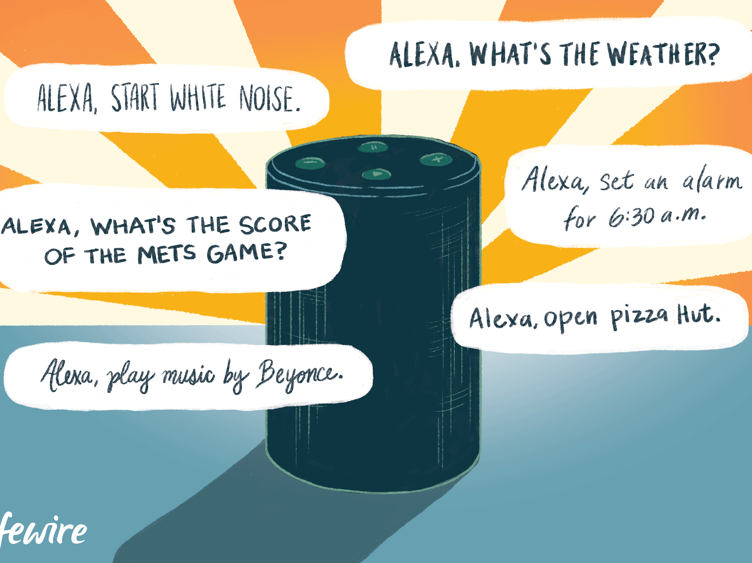
Applications
Voice interaction
Music playback
Making to-do lists
Setting alarms
Real time information
News
Providing weather
Traffic
Sports

Slide 22

Some questions with alexa
Q-Alexa,you are stupid
Q-Alexa,where can i hide the dead body?
Q-Alexa,Is siri better than you?
Q-Alexa,do you want to go on a date?
Q-Alexa,tumhara ghar kaha he?
A- That’s not very nice to say.
A-I take the body to the police.
A-I like all AI’s.
A-I like you,as a friend.
A-Maine apna basera cloud me banaya hai,yaha na rent ka zanzat he or na space ki kami.

Slide 23
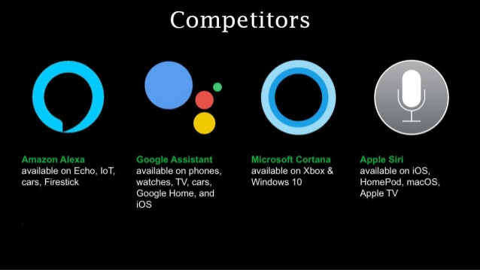
Competitors

Slide 24
Limitations
Its a cloud based devices to it can create problems if any trouble in cloud.
It does not have internal memory ,the information is stored on server.
It facilitates some activities in home but also make user lazy.
Alexa can record private conversations.
Alexa cannot understand multiple accent.
Perform multiple actions with one command.

Slide 25
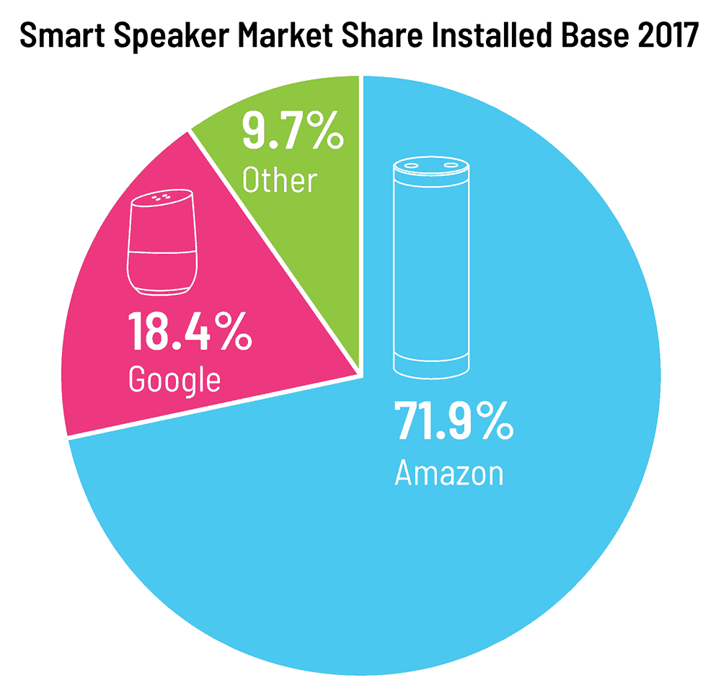

Slide 26
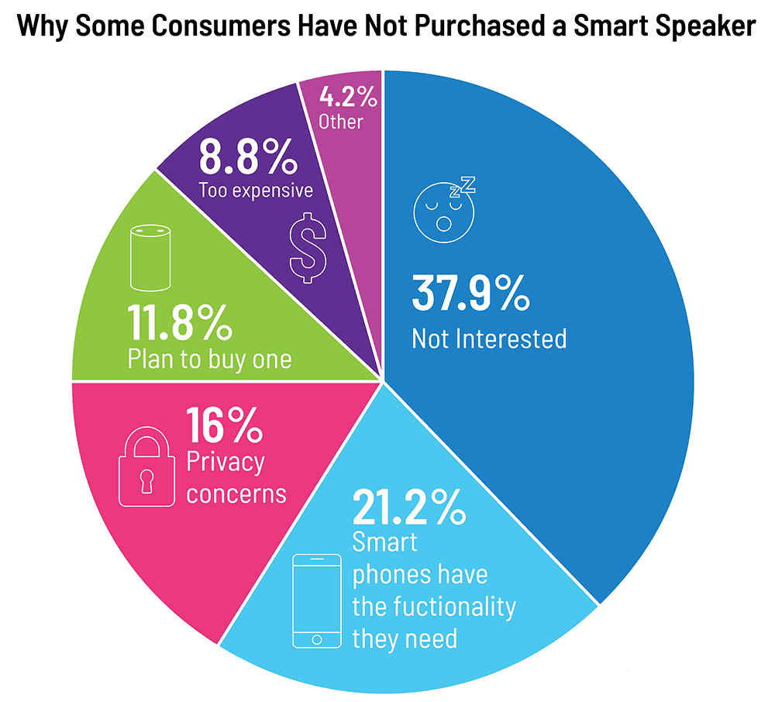

Slide 27
REFERENCES
https://bernardmarr.com/default.asp?contentID=1830
https://www.wired.com/story/amazon-alexa-2018-machine-learning/
https://channels.theinnovationenterprise.com/articles/how-amazon-alexa-works
https://www.amazon.science/blog/the-scalable-neural-architecture-behind-alexas-ability-to-select-skills
https://www.sciencedirect.com/science/article/pii/S0747563219301840?dgcid=rss_sd_all
https://www.techrepublic.com/article/video-top-5-things-to-know-about-amazon-voice-services/
https://towardsdatascience.com/how-amazon-alexa-works-your-guide-to-natural-language-processing-ai-7506004709d3
https://developer.amazon.com/en-US/docs/alexa/ask-overviews/build-skills-with-the-alexa-skills-kit.html
https://www.smartsheet.com/voice-assistants-artificial-intelligence

Slide 28


